Slide 1
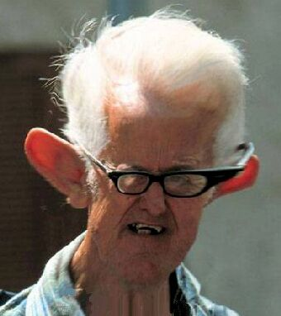
The Ears: Hearing and Balance

Slide 2
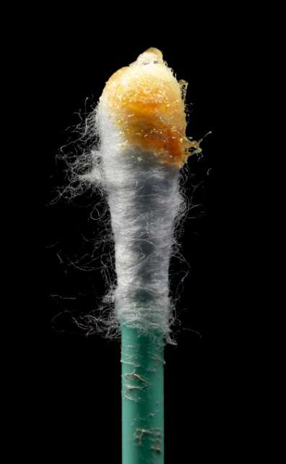
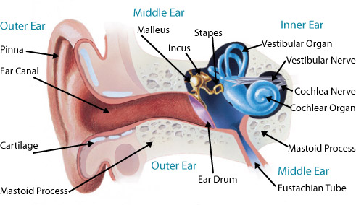
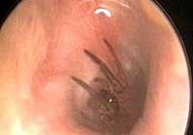
External ear-
Pinna (auricle) and acoustic meatus (ear canal) funnel sound to the tympanic membrane (eardrum)
Cerumen
(earwax) protects from drying, bacteria, fungi

Slide 3
(Auricle)
(External Auditory Meatus)

Slide 4
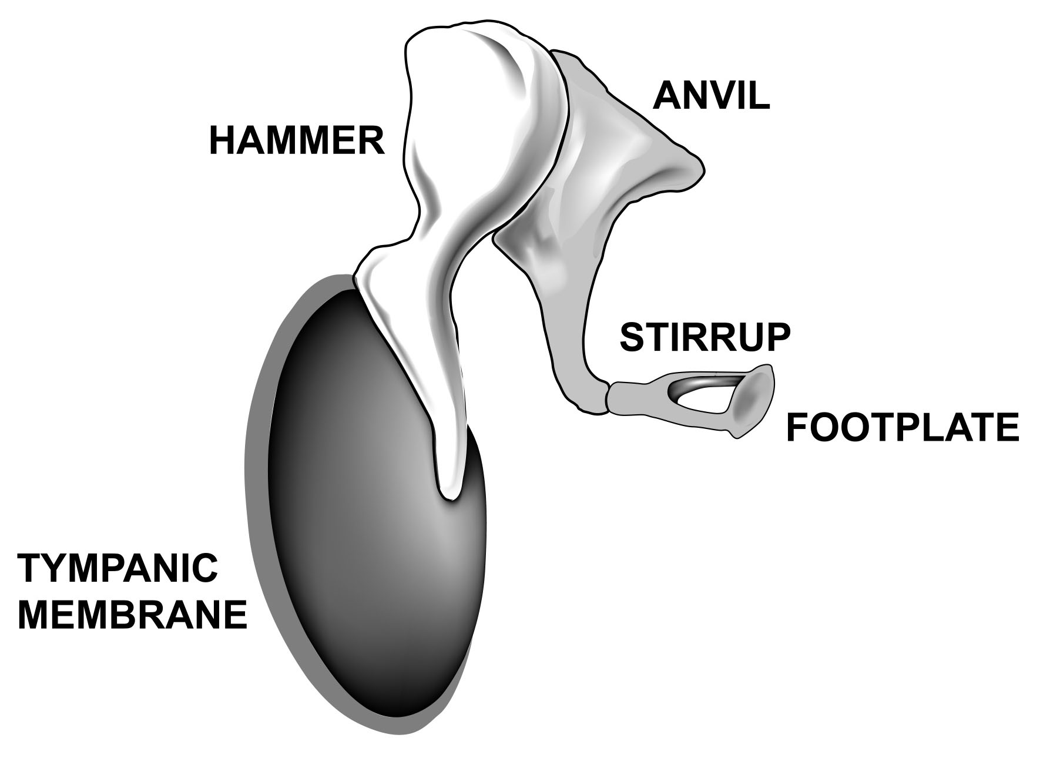
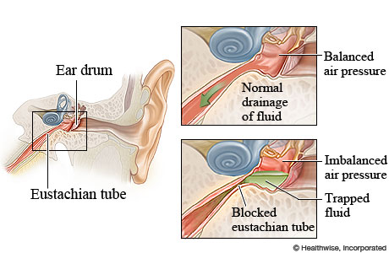
Middle ear:
3 ossicles conduct sound vibrations:
hammer (malleus)
anvil (incus)
stirrup (stapes)
Eustachian tube connects to throat and regulates air pressure for proper hearing

Slide 5
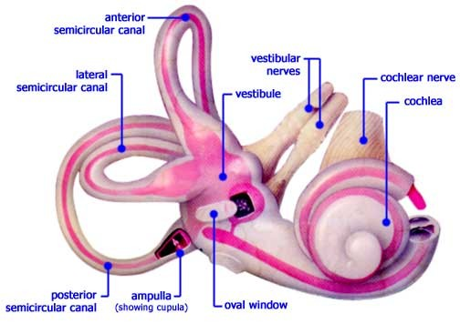
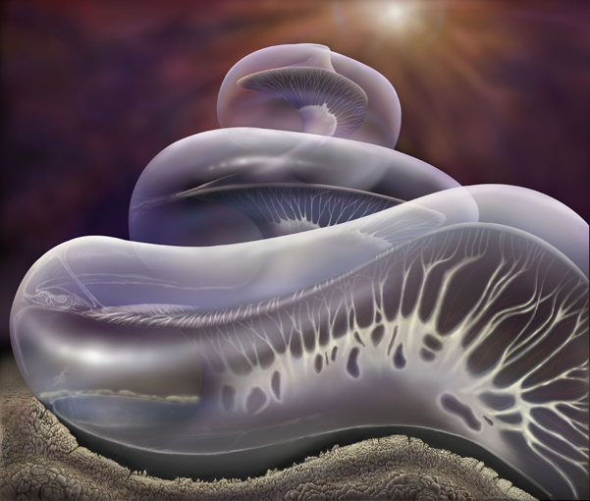
Inner ear: (the labyrinth)
Cochlea- Snail shaped hearing organ. Vibrations enter through the oval window. Hair cells on the Organ of Corti vibrate to different pitches.

Slide 6
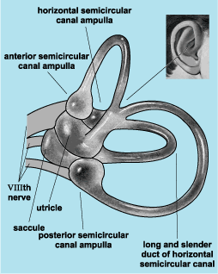
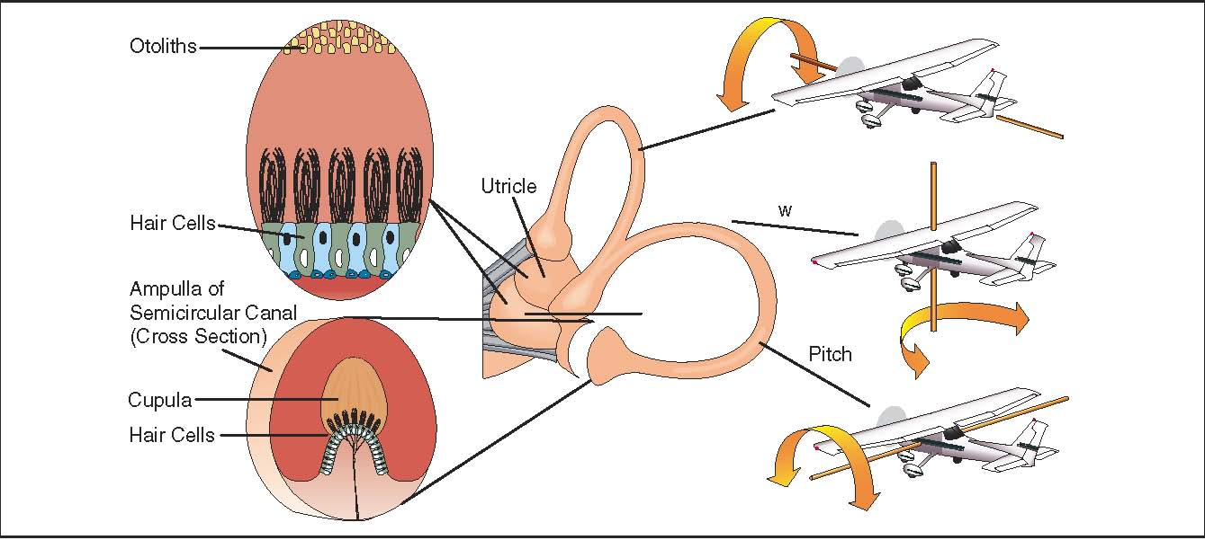
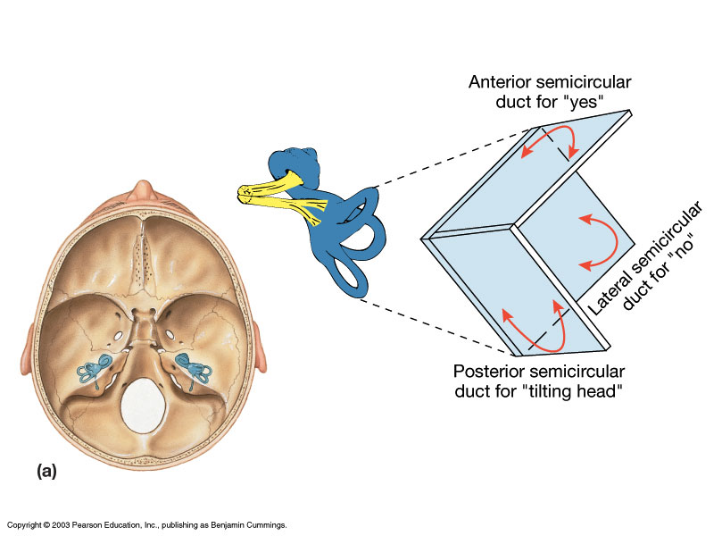
Inner ear: (the labyrinth)
Vestibule- Central fluid filled, 2 chambered cavity. Senses position relative to gravity.
Semicircular canals- 3 canals. One for each plane of 3 dimensional space. It senses movement in each direction.

Slide 7
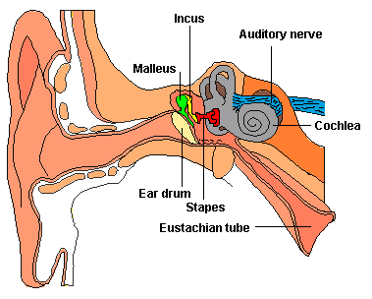
The cochlear nerve and vestibular nerves combine to form the auditory nerve which carries info to the brain.

Slide 8
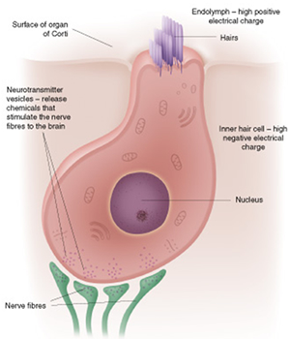
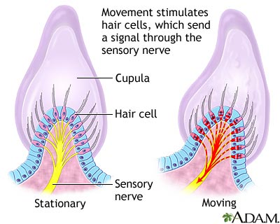
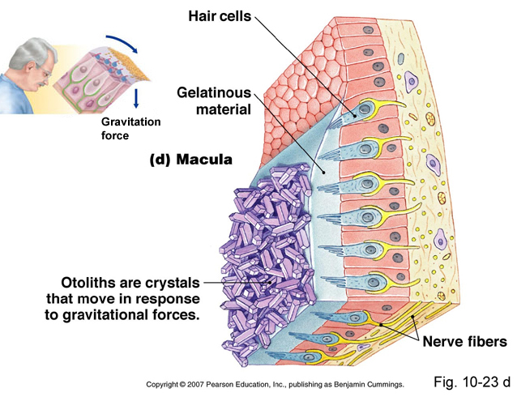
Mechanoreceptors-
-Both hearing and equilibrium (balance) rely on mechanoreceptors.
-Mechanoreceptors respond to physical movement.
-In the ear they are “hair cells”.

Slide 9
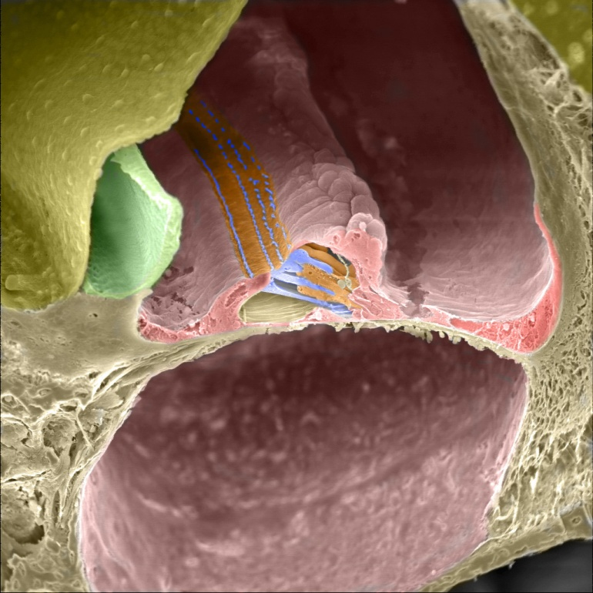
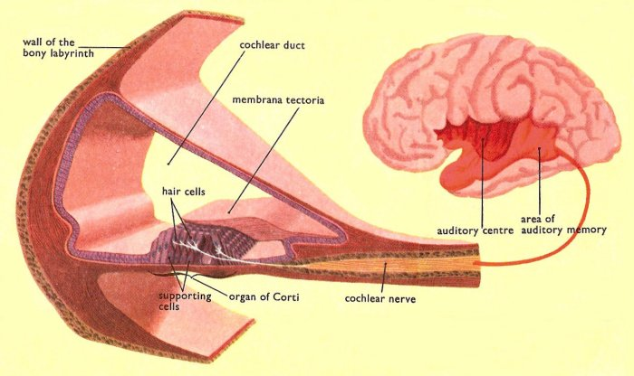
Hearing:
Organ of corti (in the cochlea): row of hair cells along a membrane.
The membrane is thin at the beginning and thicker towards the end.
-High pitch= vibrates thin membrane low pitch = vibrate thick membrane

Slide 10
Animation of basilar membrane in the cochlea:

Slide 11
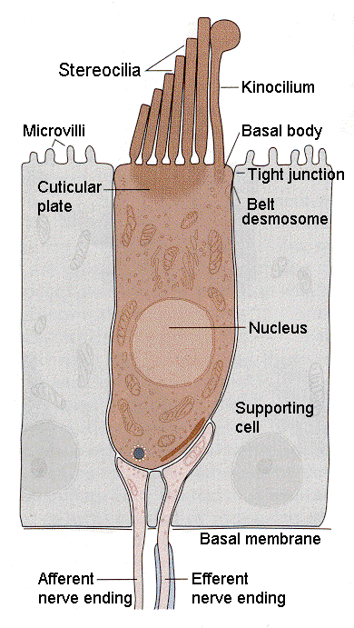
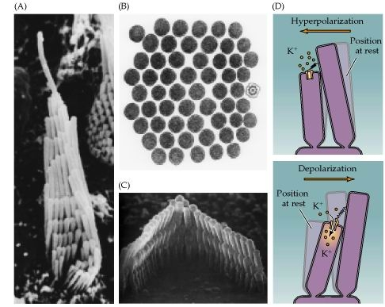
Hearing:
When hair cells in cochlea move, ion channels open and an action potential is created
The brain interprets pitch depending on which hair cells are excited. (usually a mix of several)
Loud sound= more cells excited

Slide 12
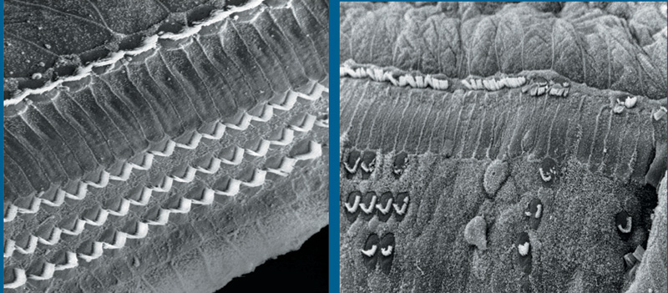
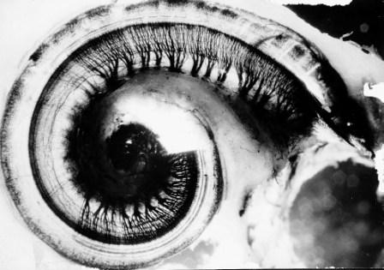
Too loud/ too long = hair cells or nerve cells destroyed

Slide 13
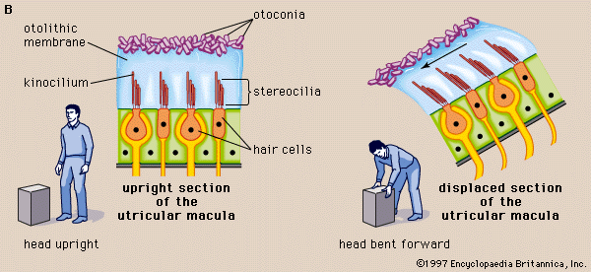
Equilibrium:
1. Static equilibrium= not moving= relationship to gravity
-Sensed in the 2 chambers of the vestibule
-A gelatin containing otoliths (“ear stones”) sits atop hair cells
-gravity moves the gelatin, stimulating hair cells= send signal to brain. (may cause righting reflex)

Slide 14
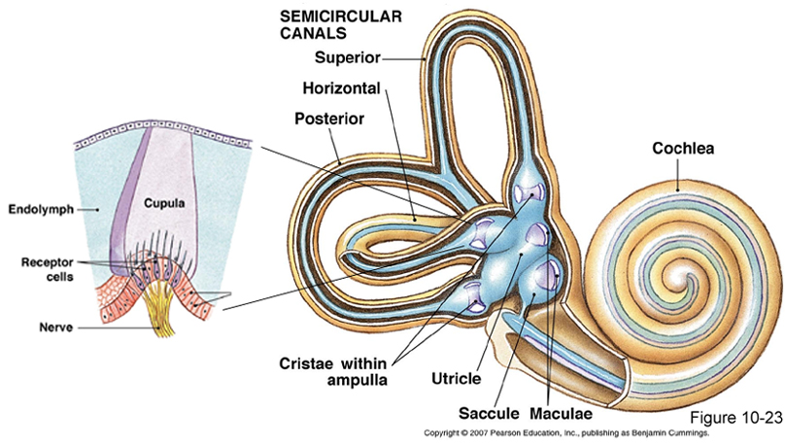
2. Dynamic equilibrium= movement/rotation of head
-Sensed in the 3 semicircular canals (3 dimensions)
-relies on the motion of fluid in the canals
-fluid pushes on a jelly like “float” sitting atop hair cells
-these sit at the base of each canal

