Slide 1
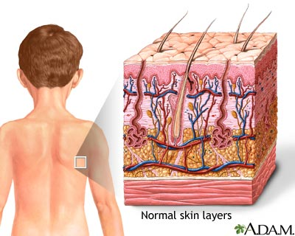
Integumentary System (Ch. 6)
Includes: Skin, hair, and nails
Called the “cutaneous” membrane, it’s the largest organ.

Slide 2
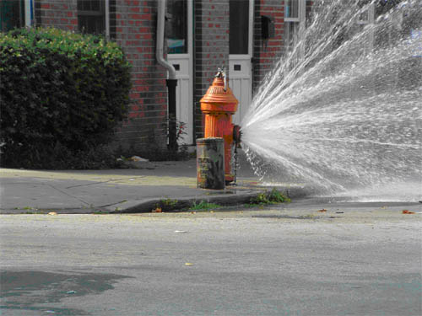
Functions of skin:
-prevent excess water loss
- protective barrier from microorganisms and UV radiation

Slide 3
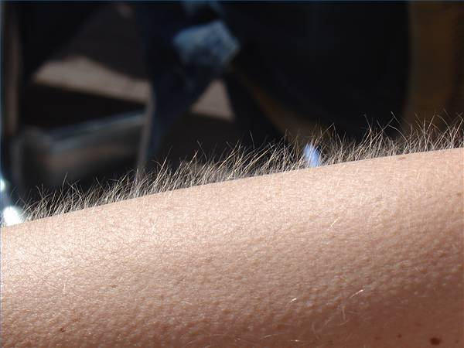
-production of vitamin D (needs sunlight)
-regulation of body temperature (sweat or goose bumps)

Slide 4
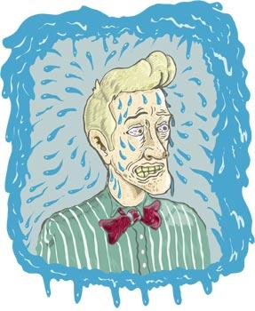
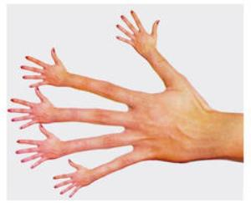
-excretion of waste (sweat)
-sensation of the environment
-immune response

Slide 5
Structure of skin:
-contains all 4 tissue types! (can you name them?)
-3 main layers:
Epidermis
Dermis
Hypodermis

Slide 6
Epidermis- several layers of epithelium called “strata”
corneum- uppermost layer of dead cells
contains the tough, waterproof protein keratin
lucidum- (only in “thick skin”)
granulosum-
spinosum-
basale- where mitosis occurs, the “newest skin”
melanocytes here pigment the skin

Slide 7
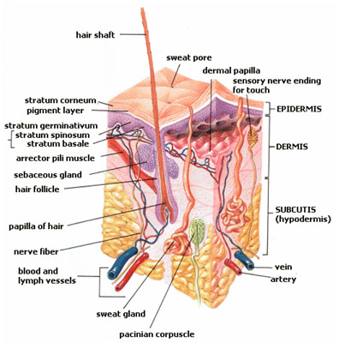
Dermis- mostly connective tissue (collagen and elastin fibers) and highly vascular
contains the following:
-sweat glands
-sebaceous glands: produce oil (near hair follicles)
-hair follicles : epithelial “tubes” that grow hair
-hair: made of keratin (protein) & melanin (pigment)
-arrector pili muscle: make hair stand up
-sensory receptors: (nerve endings)

Slide 8
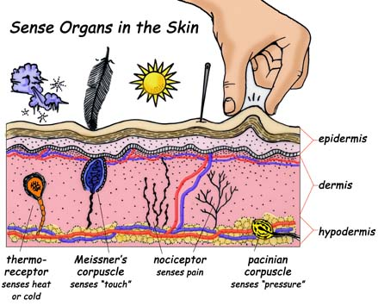
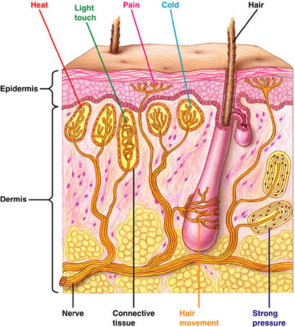
Nerve ending of the skin- (cutaneous sensory receptors)
There are receptors for:
Cold
Pain
Itch
Light Touch
Hot
Tickle
Pressure

Slide 9
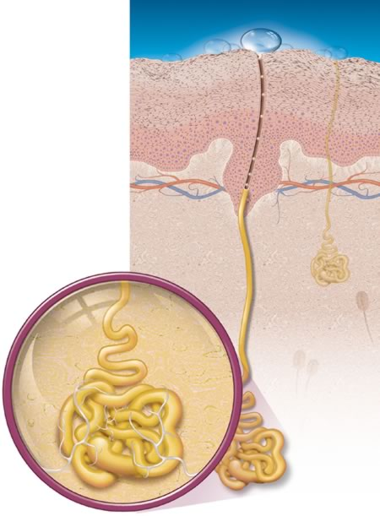
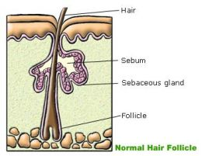
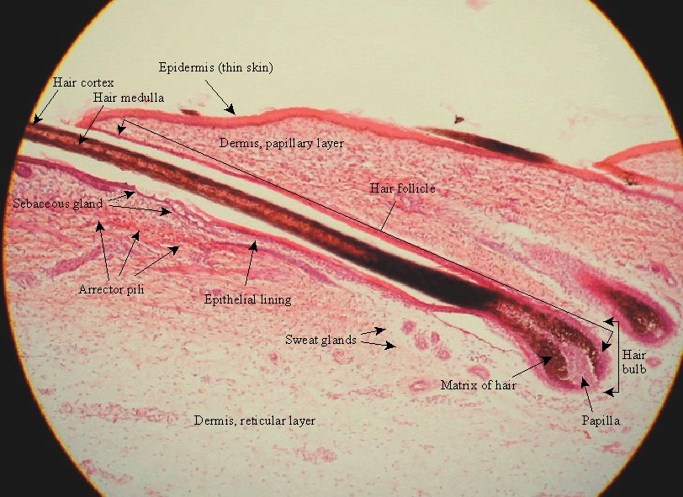
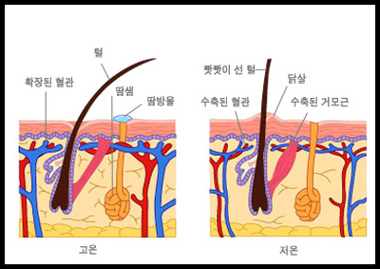

Slide 10
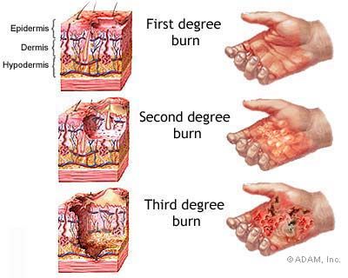
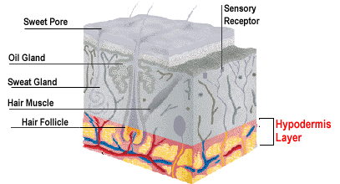
Hypodermis- sometimes called “subcutaneous”
may contain:
loose connective tissue connecting to muscle or bone
adipose tissue for fat storage

Slide 11
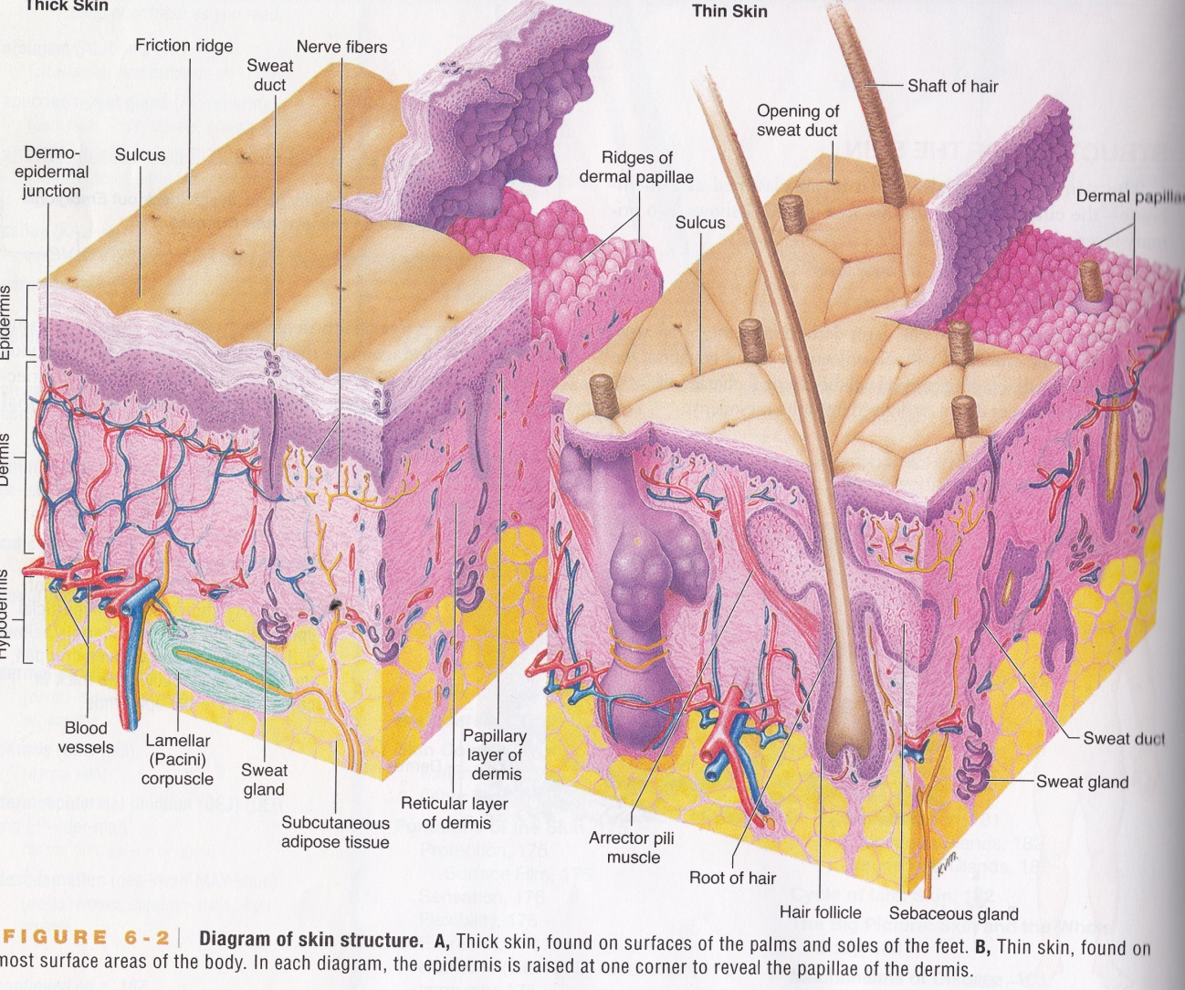
Thick vs. Thin Skin
Thick:
Palms and soles of feet
No hair
Friction ridges (finger prints)
Only epidermis is thicker
Thin:
Covers vast majority of the body

