Slide 1
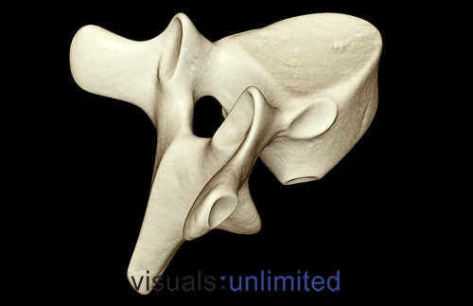
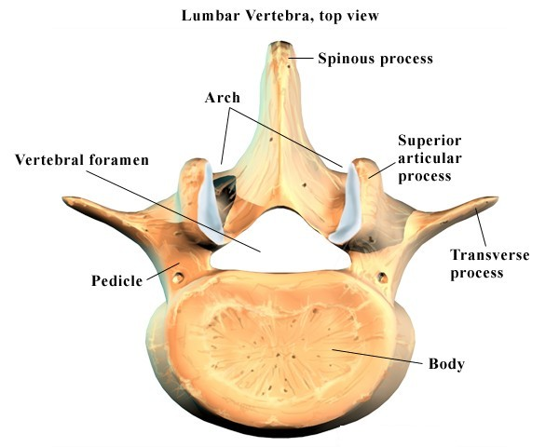
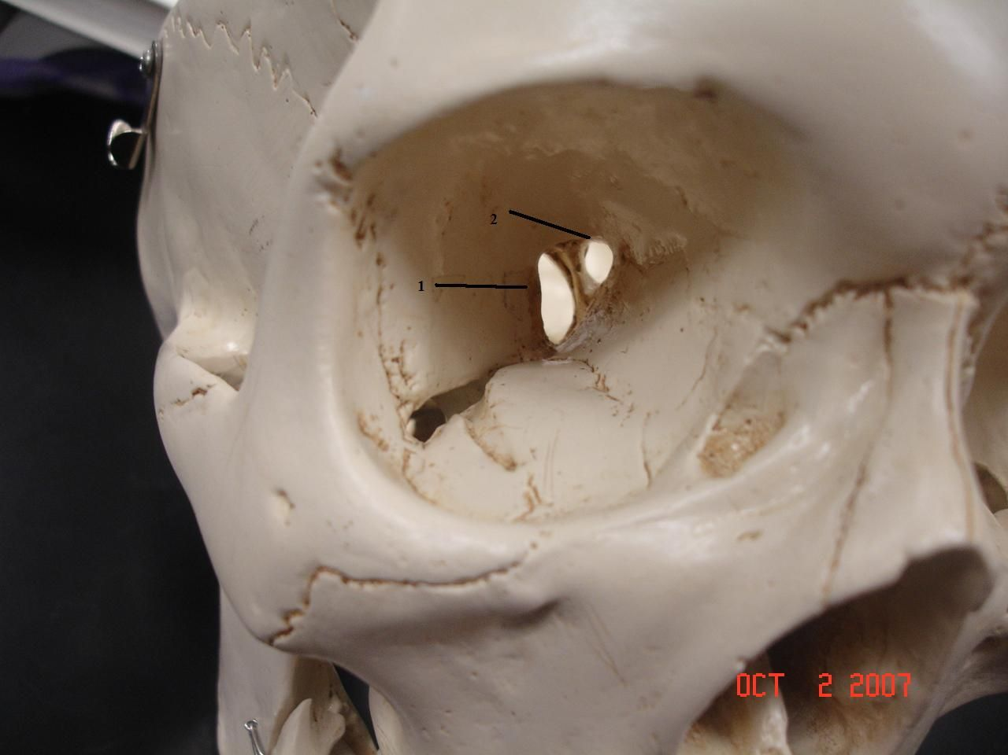
Process: a raised area or projection
Fissure: Long, crack-like hole for blood vessels and nerves

Slide 2
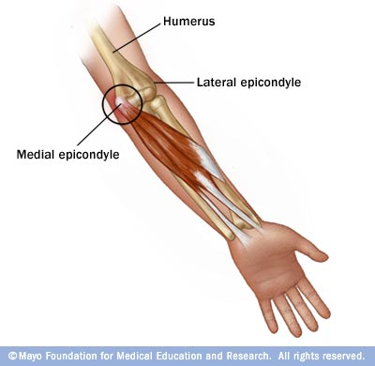
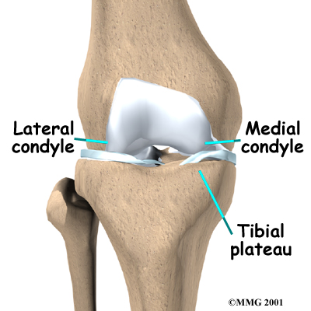
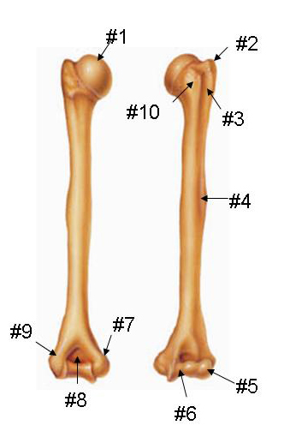
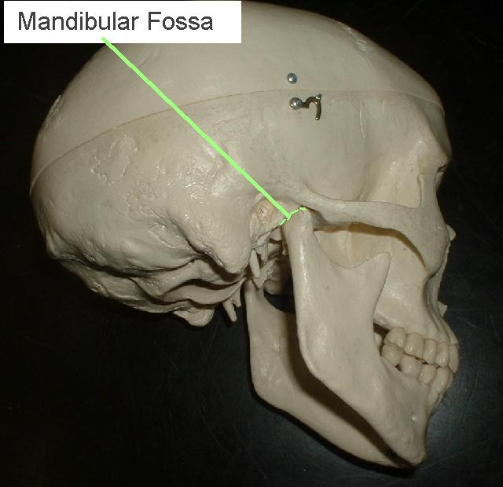
Condyle: rounded bump usually fitting into fossa of another bone to form a hinge joint
Epicondyle: bump near a condyle; for muscle attachment.
Fossa: a depression that recieves an articlating bone.

Slide 3
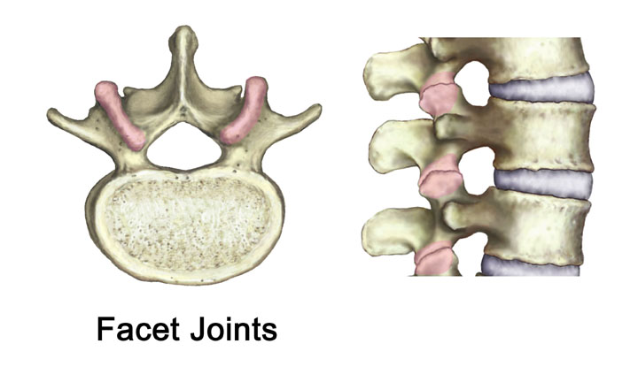
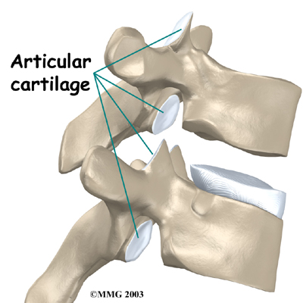
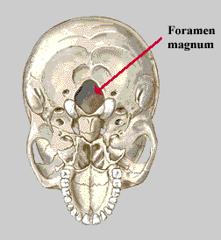
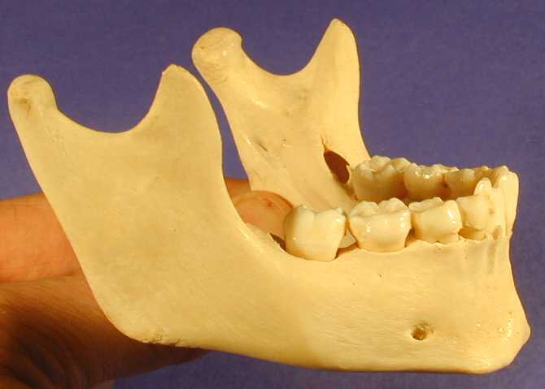
Facet: a flat surface that forms a joint with another flat surface
Foramen: a round hole for blood vessels and nerves

Slide 4
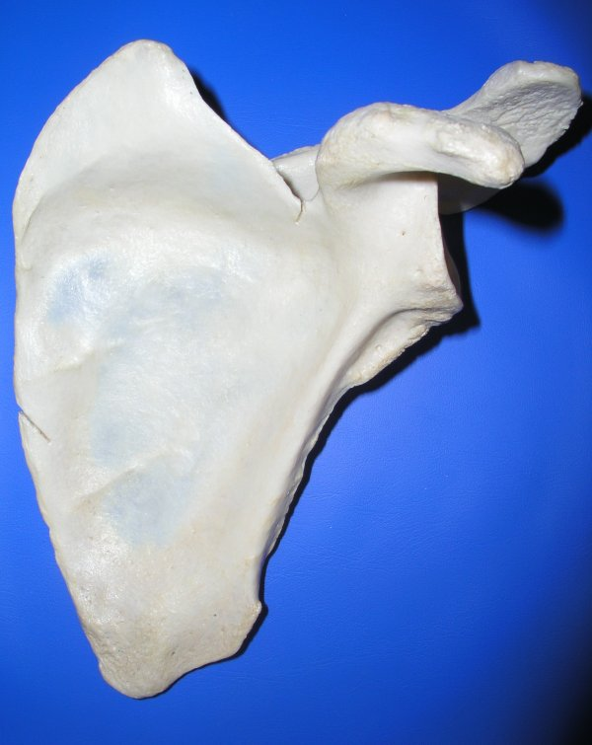
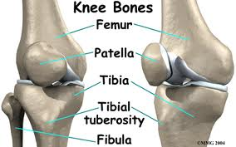
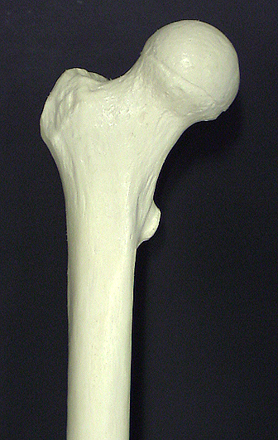
Margin: the edge of a flat bone
Trochanter: LARGE bump for muscle attachment
Tuberosity: SMALL bump for muscle attachment

Slide 5
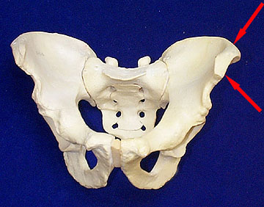
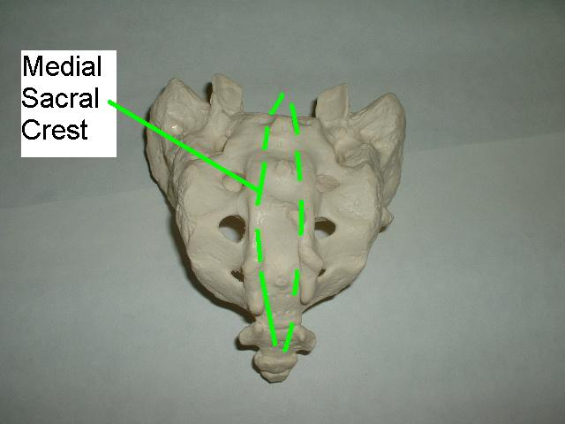
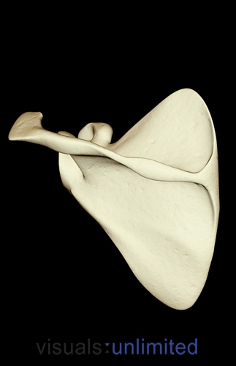
Crest: a moderately raised ridge, generally for muscle attachment
Spine: Similar to a crest but raised MORE. A sharply raised process for muscle attachment

Slide 6
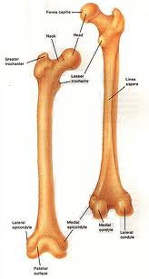
Head: distinct epiphysis separated from the shaft of long bone

